Slide 1
CODER BLOG

Slide 2
CODER BLOG
TEAM MEMBERS:
K.VAMSI MOHAN REDDY(19091A05H3)
A.SAI THANU SREE(19091A05C7)
L.VASAVI(19091A05H4)
V.SANJAY(18091A05C0)
Under the guidance of
Dr. N MADHUSUDHANA REDDY M.Tech &Ph.D
PROFESSOR
COMPUTER SCIENCE AND ENGINEERING

Slide 3
CONTENTS
ABSTRACT
INTRODUCTION
EXISTING SYSTEM
DRAWBACKS OF EXISTING SYSTEM
PROBLEM STATEMENT
PROPOSED SYSTEM
ADVANTAGES OF PROPOSED SYSTEM
REQUIREMENTS
MODULES
A BRIEF VIEW OF SYSTEM ARCHITECTURE

Slide 4
CONTENTS
UML DIAGRAMS
a. USE CASE DIAGRAM
b. CLASS DIAGRAM
c. SEQUENCE DIAGRAMS
d. ACTIVITY DIAGRAM
RESULTS
PROGRESS OF WORK
CONCLUSION
FUTURE ENHANCEMENT
REFERENCES

Slide 5
ABSTRACT
In the world of computer science most of the students are concentrating on programming knowledge. To maximize the ability in programming students are learning code from different sites.
In this mini project we aimed to increase the programming skills of users by posting programming related questions with the help of person who has knowledge in that particular programming language.
The answers from users will be considered by faculty by analyzing the logic users will get a review and solution will be maintained.
This web-based application builds competitiveness in students.

Slide 6
INTRODUCTION
Coder blog is a web based application regarding programming assignments especially for computer science students. In this website programs could be posted by admin or faculty.
This mini project explains about implementing a website which is convenient to use for both student and faculty about programming related questions.
Faculty can easily broadcast a question to all users of the website and students can be able to submit the solution with valid login details.
This also aims at enhancing interaction between students and faculty as well as among students.

Slide 7
EXISTING SYSTEM
We have observed that faculty give list of programming related questions to solve as a task or as an assignment.
They give the programs which are related to what they are teaching currently at that time.
Sometimes to improve knowledge in particular topic what they have taught they give programming questions to students on daily basis.

Slide 8
DRAWBACKS OF EXISTING SYSTEM
Need more written work
No effective solutions
Not all students are efficient in programming and everyone cannot get effective solutions for programs.
Students cannot get previously posted questions and solutions easily after submission.
Access issues

Slide 9
PROBLEM STATEMENT
In most of the colleges faculty provide programming questions to students to improve the ability of programming skills.
It can be easy to post to everyone by group and but it can be difficult to collect those programs individually.
Another problem is some may lost the previous programs.
To broadcast the questions and answers with specified details we need some application.

Slide 10
PROPOSED SYSTEM
The proposed system is digitalizing all the operations what the existing system consists. For that we need on website or application.
So we propose “CODER BLOG” website which facilitates all the operations of the user.
Each user or student will have a unique login credentials.
Admin or Faculty can be able to post questions, analyse submissions and gives feedback.
Students can post the solutions within specified time limit so that it will be competitive for them.

Slide 11
ADVANTAGES OF PROPOSED SYSTEM
Availability
As it will be an online website, availability is ensured all the ways.
Zero expenses
Services are provided at free of cost.
Programming acknowledgement
This application not only provides and maintains effective solutions but also acts as a knowledge hub regarding programming languages.
Easy access
Accessing will be easy and also cost free.

Slide 12
REQUIREMENTS
SOFTWARE REQUIREMENTS:
Software : XAMPP Server Version 8.0.14
Scripting languages : HTML 5, CSS, JAVASCRIPT, PHP version 5 or above
Database : MySQL
Operating System : Windows 7 or above
HARDWARE REQUIREMNTS:
Hard Disk Drive : 500 GB(using 512 gb)
Processor : using intel core i5
RAM : using 8 GB

Slide 13
MODULES
In this “CODER BLOG” as of now we are proposing two modules those are user module and admin module.
User module:
Here user means student. First user have to create an account.
After successful login the privileges provided to the students are student can be able to post answers to questions, can check the previous programs and its submissions.
Admin module:
Here admin will be faculty. Admin also will have an account with unique login credentials.
Admin can be able to post programming question and can also evaluate submissions of it and gives feedback to the students based on their solution efficiency.

Slide 14
SYSTEM ARCHITECTURE
ADMIN
POST QUESTION
ANALYSE SOLUTIONS
PROVIDE FEEDBACK
LOG IN
USER
(STUDENT)
POST ANSWER
VIEW PREVIOUS
QUESTIONS
LOG OUT

Slide 15
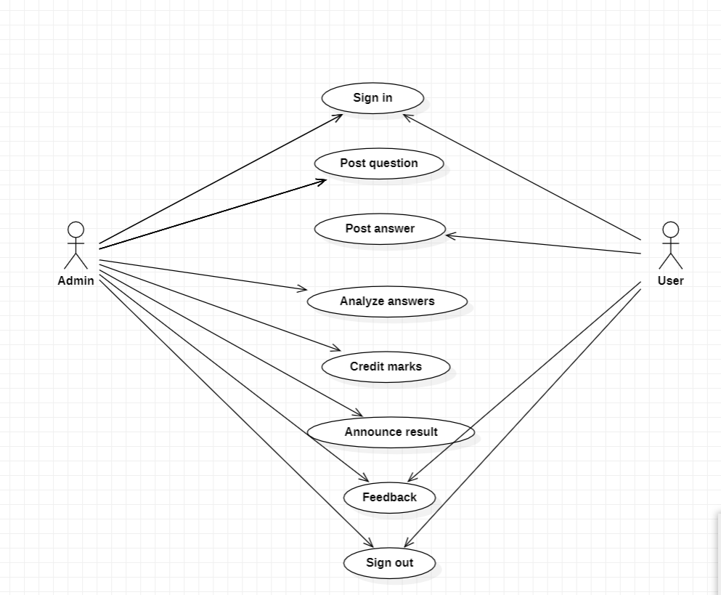
UML DIAGRAMS
Use Case Diagram

Slide 16
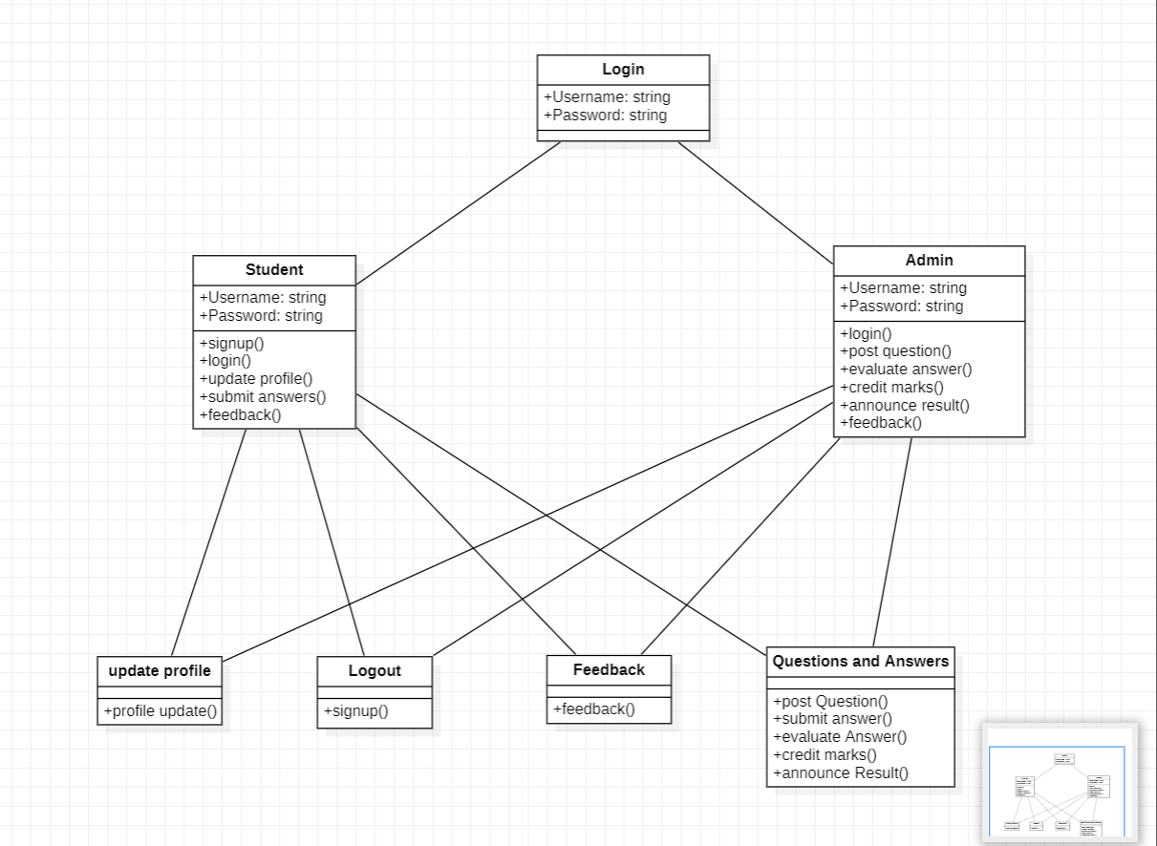
b. Class diagram

Slide 17
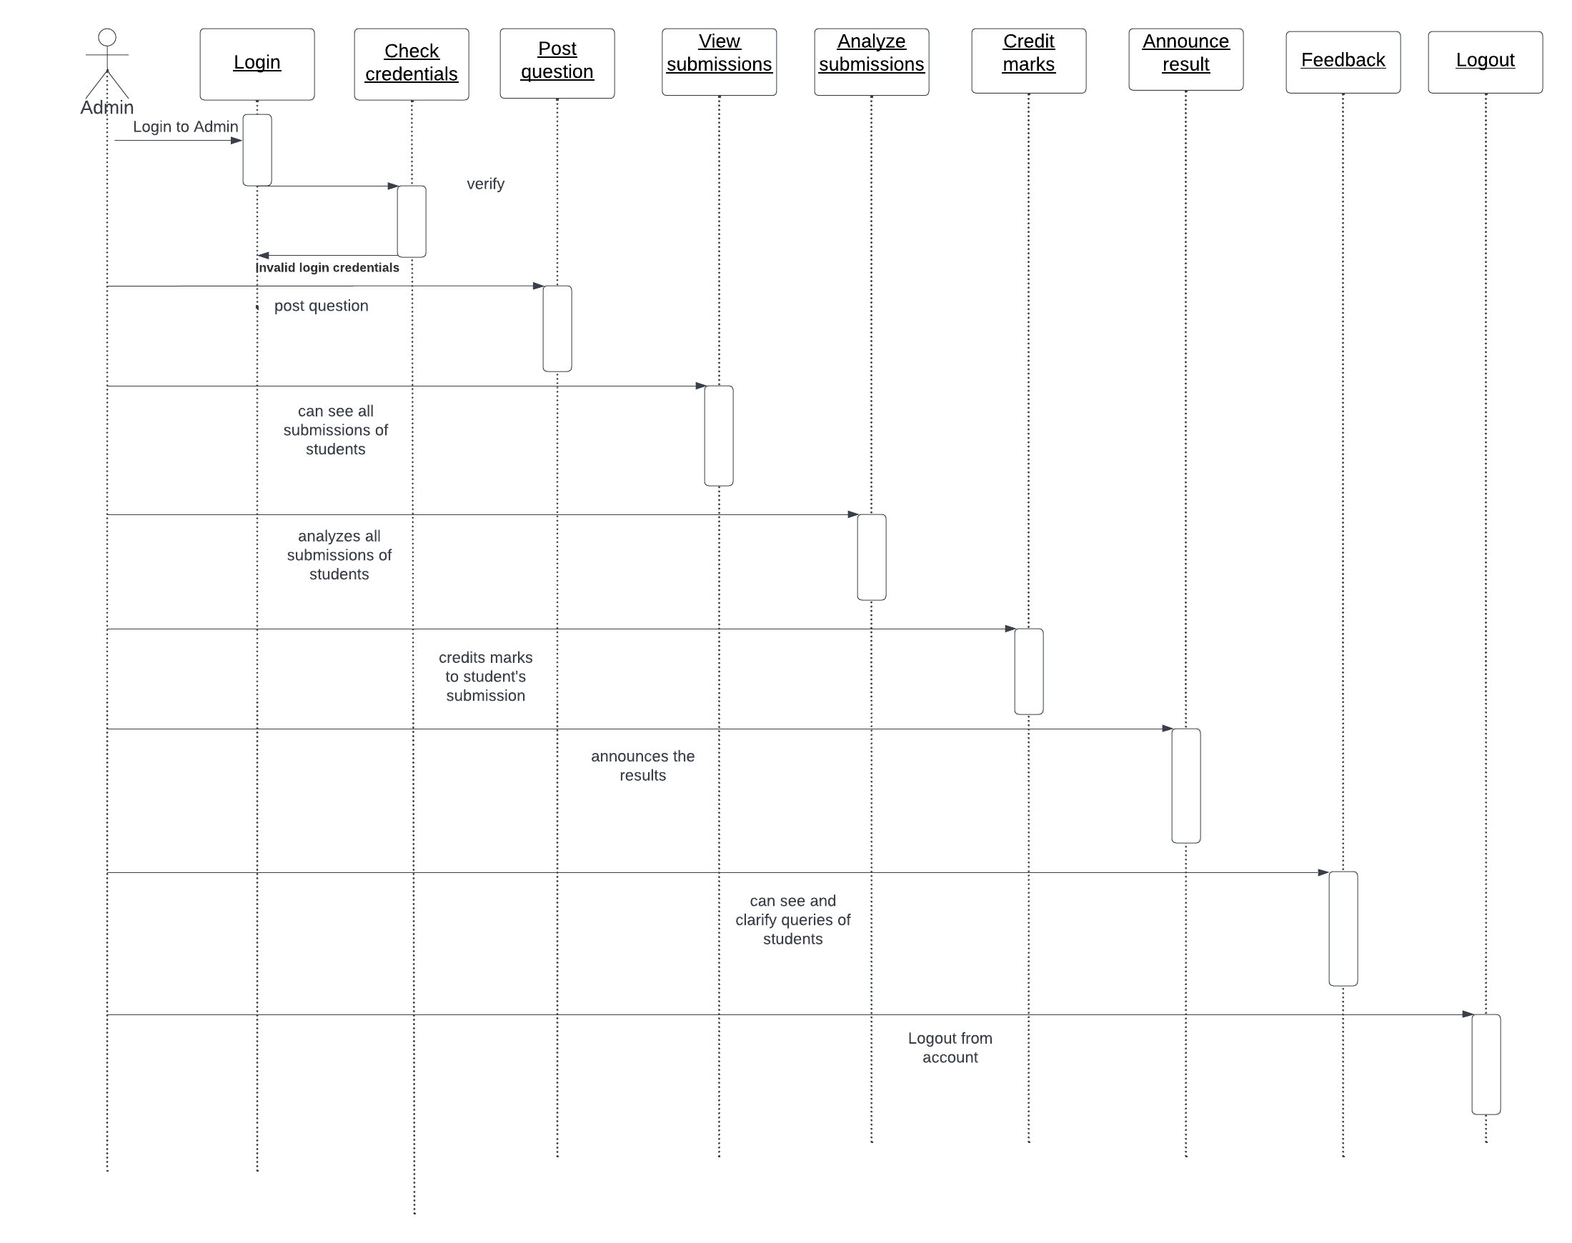
c. Sequence diagram for Admin

Slide 18
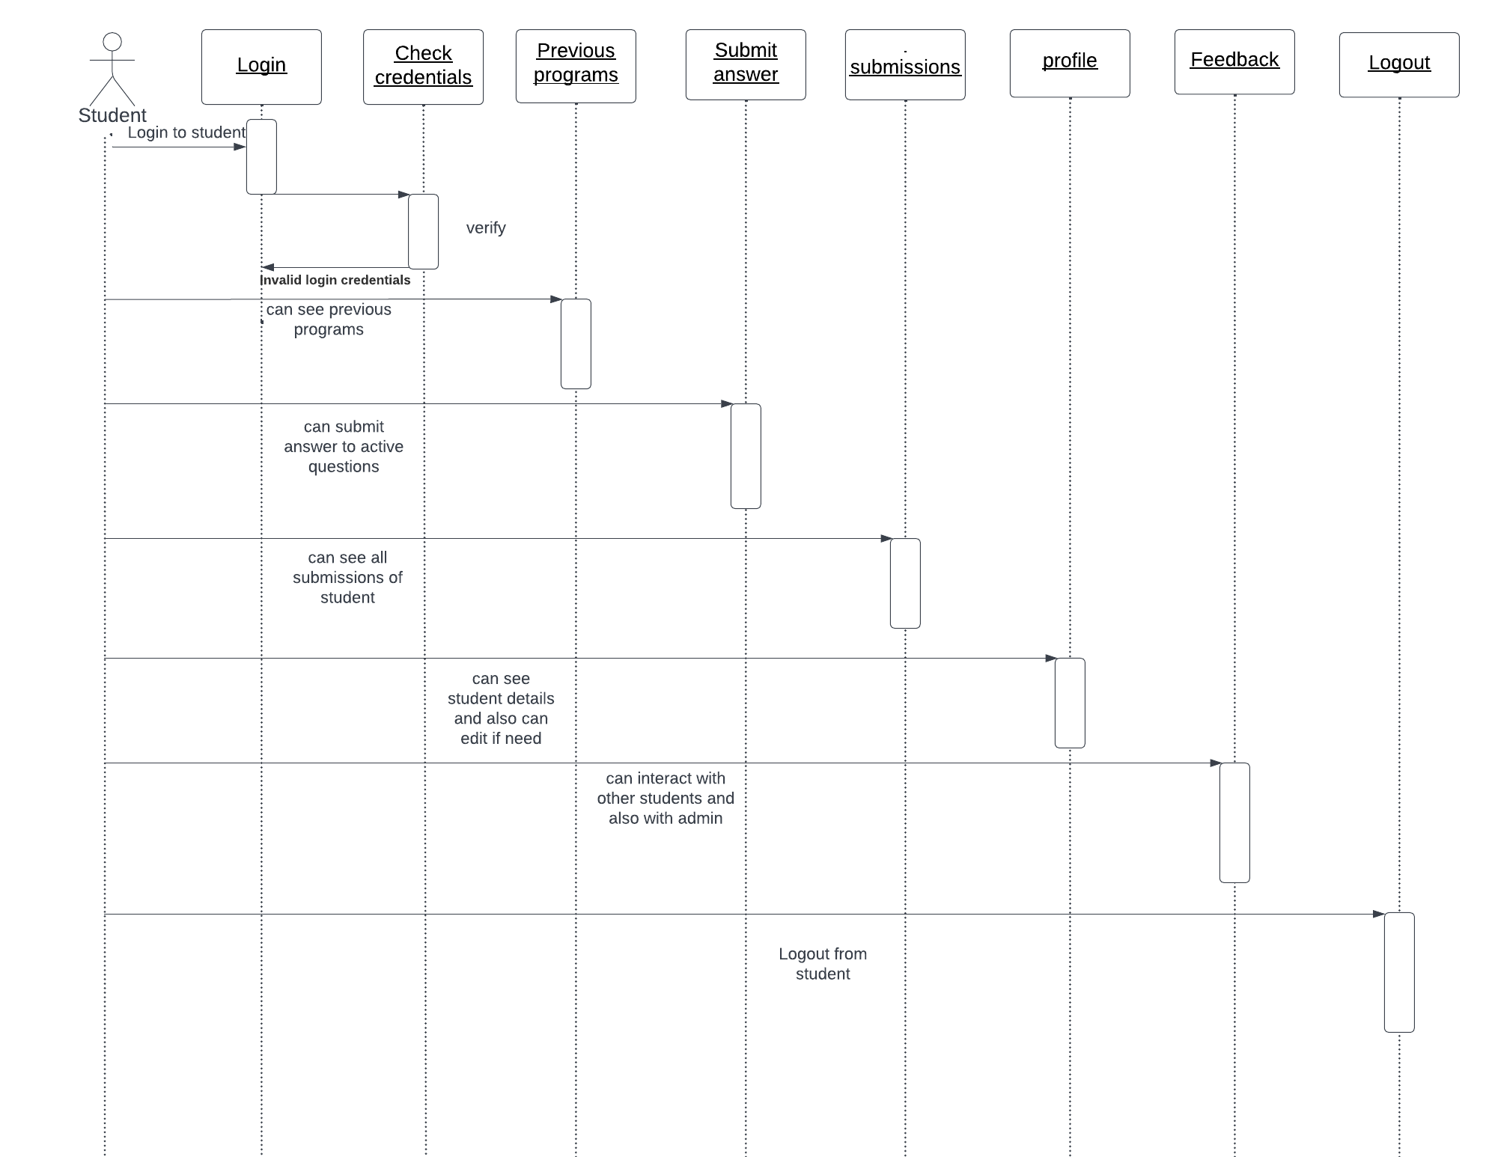
d. Sequence diagram for Student

Slide 19
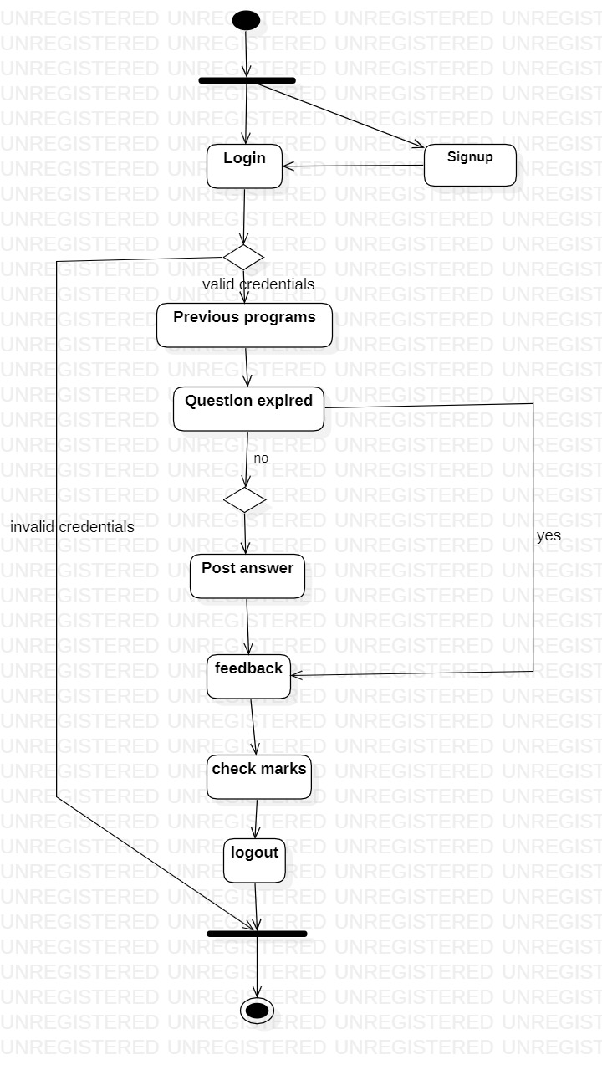
e. Activity Diagram

Slide 20
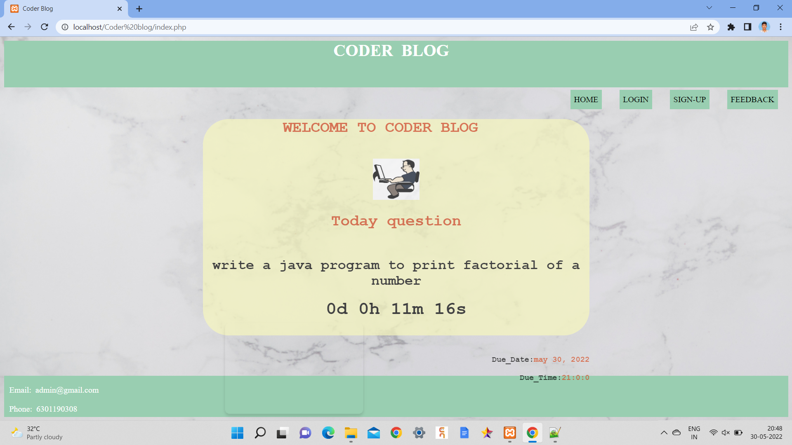
RESULTS
Home page

Slide 21
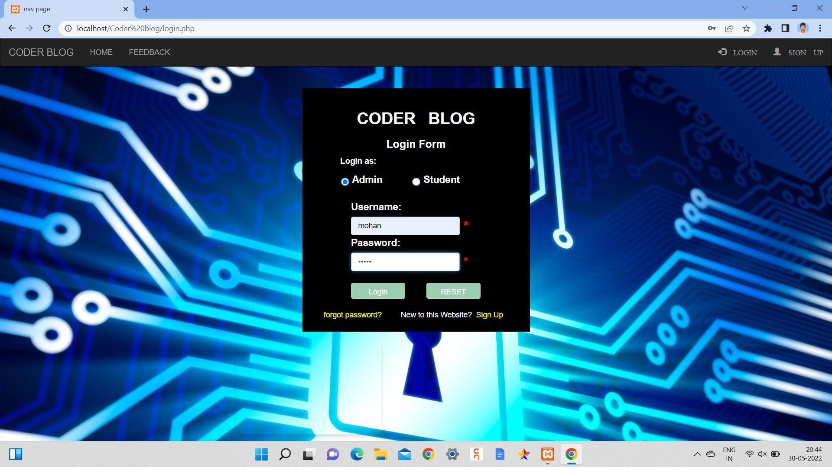
Login page

Slide 22
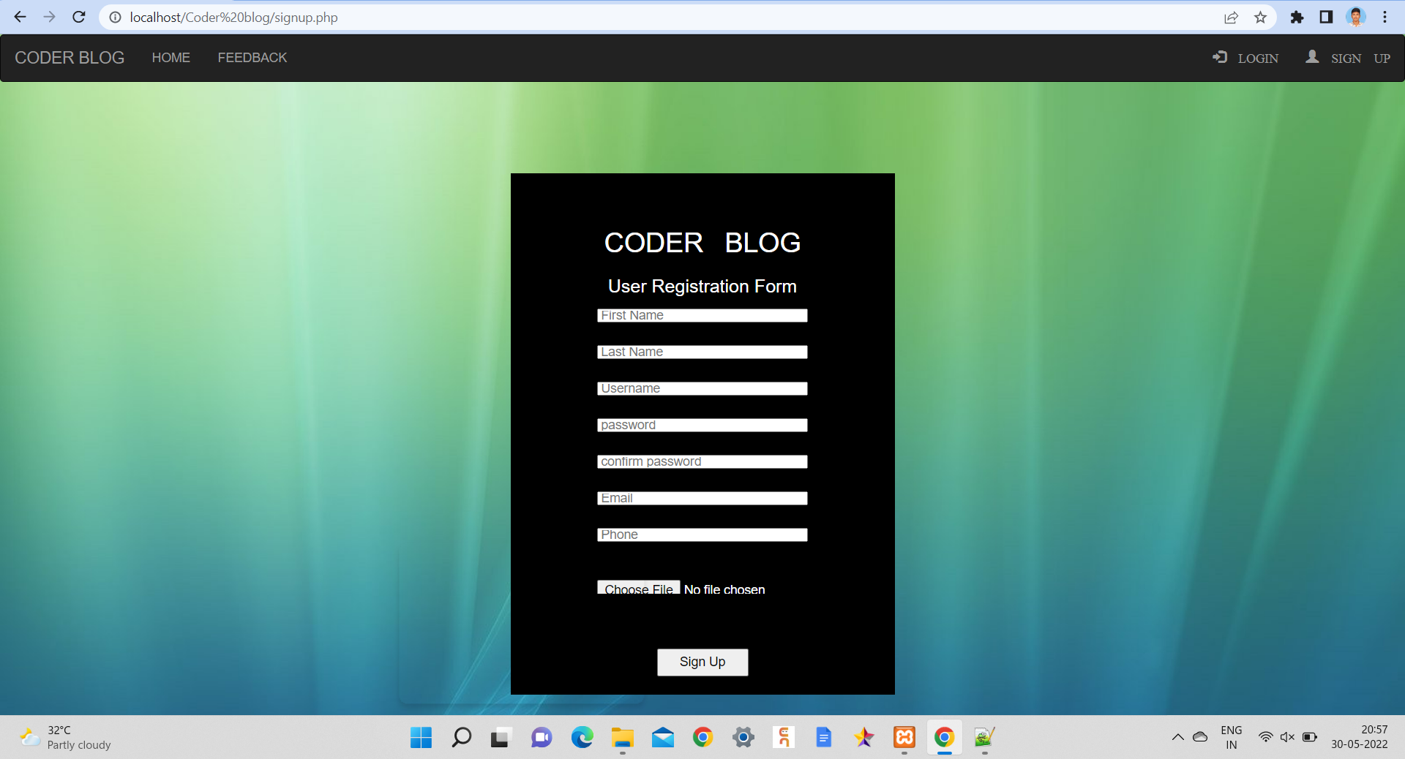
User registration page

Slide 23
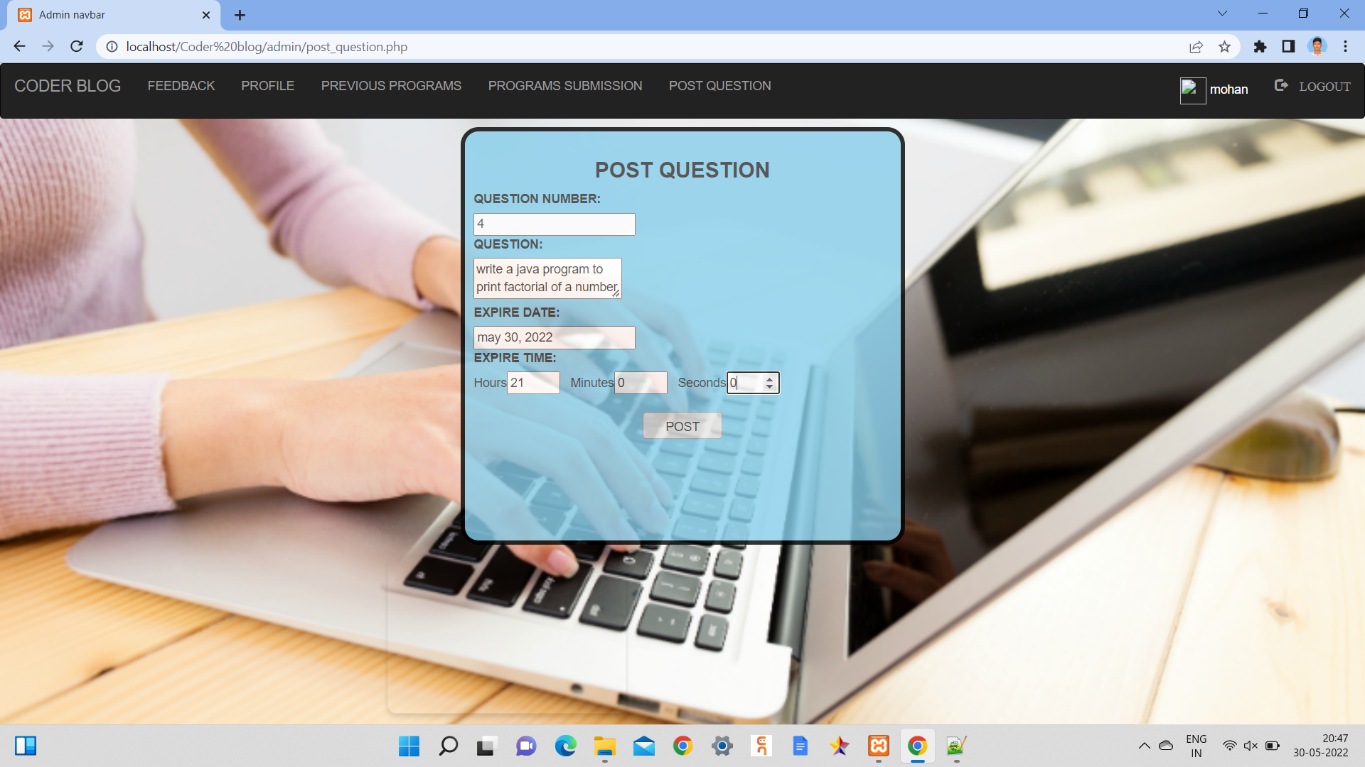
Post question page

Slide 24
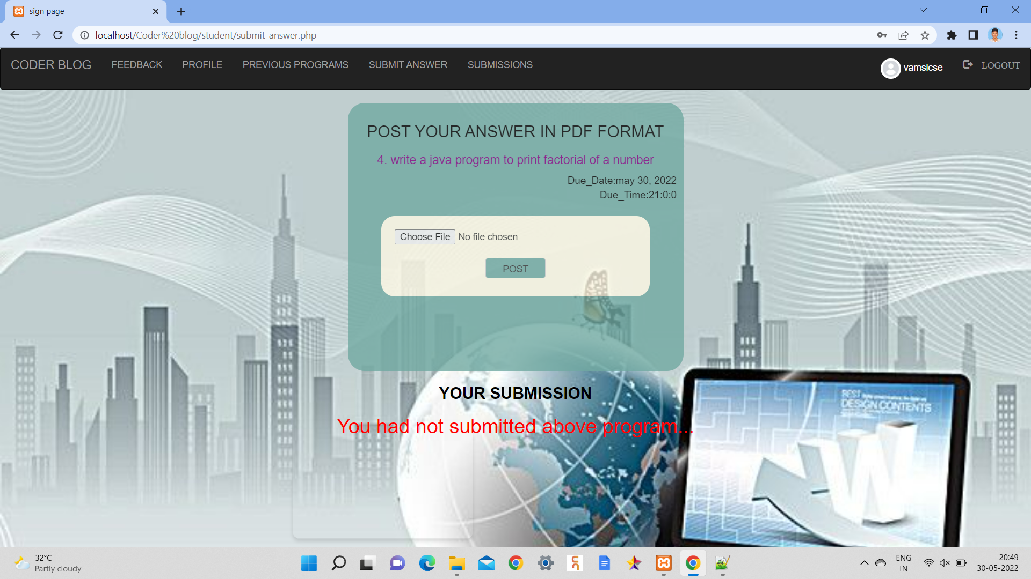
Submit answer page

Slide 25
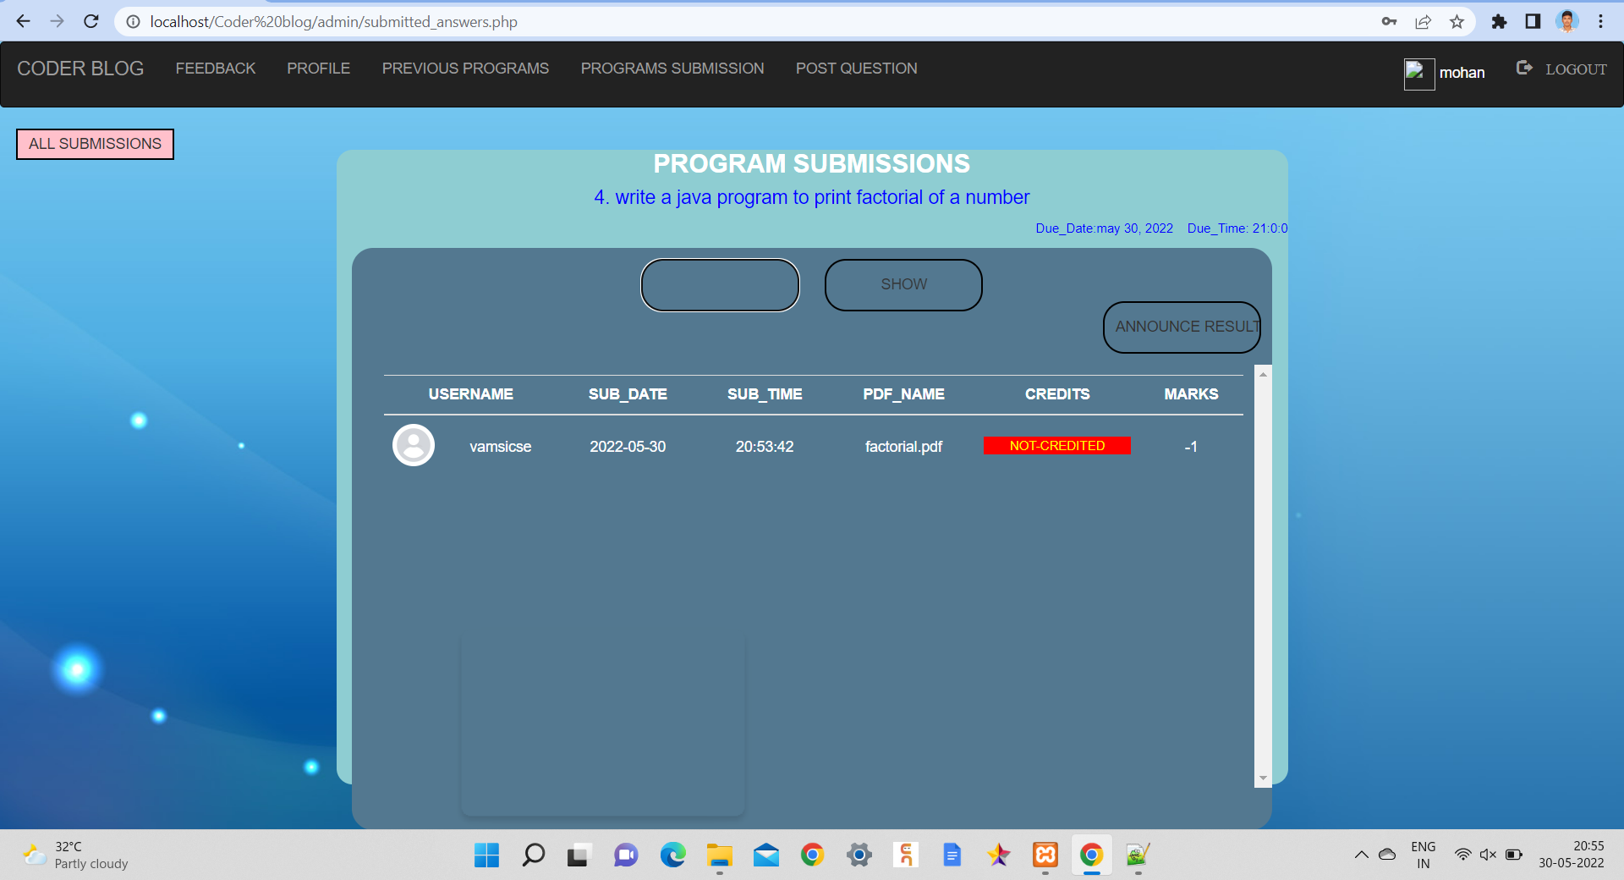
Current submissions page

Slide 26
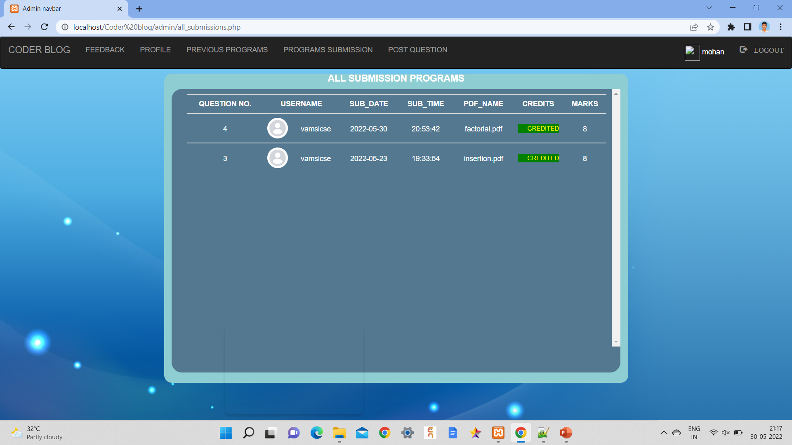
All submissions page:

Slide 27
PROGRESS OF WORK
70 percent of the implementation had been done. Remaining 30 percent has to be implemented and later testing and finding of errors has to be performed.

Slide 28
CONCLUSION
This website will benefit the students as well as faculty. It makes the entire process online where students can submit there assignments and works related to programming languages.
It facilitates the timer to submit the work within the given limit which is entered by admin.
Admin can easily check who has submitted the answers and can also recognize who haven’t got the marks with the label of credit.
It also facilitates to ask question in feedback section for any references.
This system builds competitiveness in the user which makes them to improve the programming knowledge.

Slide 29
FUTURE ENHANCEMENTS
There is a future scope of this system that many more features like online lectures or video tutorials can be added by admin along with assignment submission facility.
Some other features like notice board makes this project more interactive and fulfils users need in the best way possible.

Slide 30
REFERENCES
IEEE paper:
PASS - A programming assignment submission system(https://www.researchgate.net)
For html and css we referred- https://www.w3schools.com/html
For php and MYSQL we referred - https://www.javatpoint.com/php-tutorial

Slide 31
THANK YOU

